Slide 1


AWS DataSync
Gabriella Thorne

Slide 2
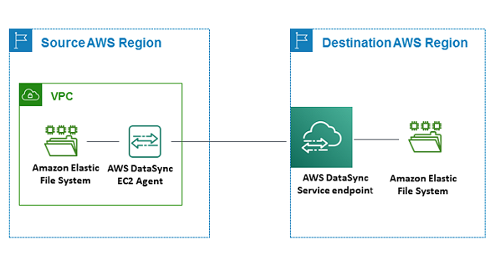
What is AWS DataSync?
An online data movement and discovery service that simplifies data migration
A way to copy data and metadata between AWS services
Enables automated replication for data protection and recovery.
Notes:
It allows customers securely move their files, objects, and data to, from, and between AWS storage services.

Slide 3

What services work with AWS DataSync?
Network File System (NFS) file servers
Server Message Block (SMB) file servers
Hadoop Distributed File System (HDFS)
Object storage systems
Amazon S3 buckets
Amazon EFS file systems
Amazon FSx for Windows File Server
Amazon FSx for Lustre file systems
Amazon FSx for OpenZFS file systema
Amazon FSx for NetApp ONTAP file systems
AWS Snowcone devices
Google Cloud Storage buckets
Microsoft Azure Files
Microsoft Azure Blob Storage (preview)
Notes:
AWS DataSync comes pre-installed on AWS Snowcone to enable simple, fast, secure, and cost-effective online data import or export

Slide 4

Use Cases
Data migration – Rapidly move active datasets over the network into An AWS service
Archiving cold data – Move cold data stored in on-premises storage directly to durable and secure long-term storage
Data replication – Copy data into any Amazon S3 storage class, choosing the most cost-effective storage class for your needs
Data movement for timely in-cloud processing
Notes:
And includes automatic encryption and data integrity validation to help make sure that your data arrives securely, intact, and ready to use.

Slide 5
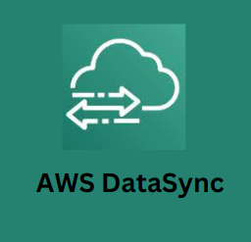
Benefits
Simplify and automate data movement
Transfer data securely – DataSync provides end-to-end security,
DataSync uses a purpose-built network protocol and a parallel, multi-threaded architecture to accelerate your transfers
Reduce operational costs – Move data cost-effectively with the flat, per-gigabyte pricing of DataSync.

Slide 6
Thank you for your time!

